Slide 1
Day 07
Horn's Method and Fiducial Localization Error

Slide 2
Horn's Method and FLE
Horn's method (and all other ordinary least-squares methods) is optimal when FLE is identical and isotropic
{L}
{R}

Slide 3
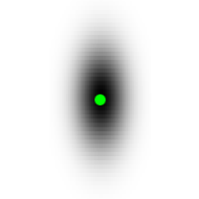
Anisotropic FLE
in most optical tracking systems, measurement error is largest along the viewing direction
{L}
{R}

Slide 4
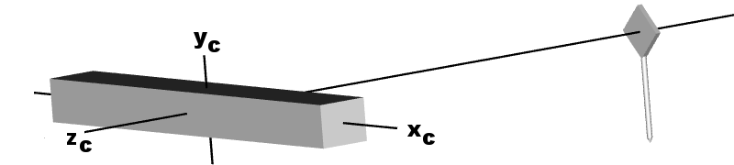
Anisotropic FLE
what happens if the DRB rotates about x-axis?

Slide 5
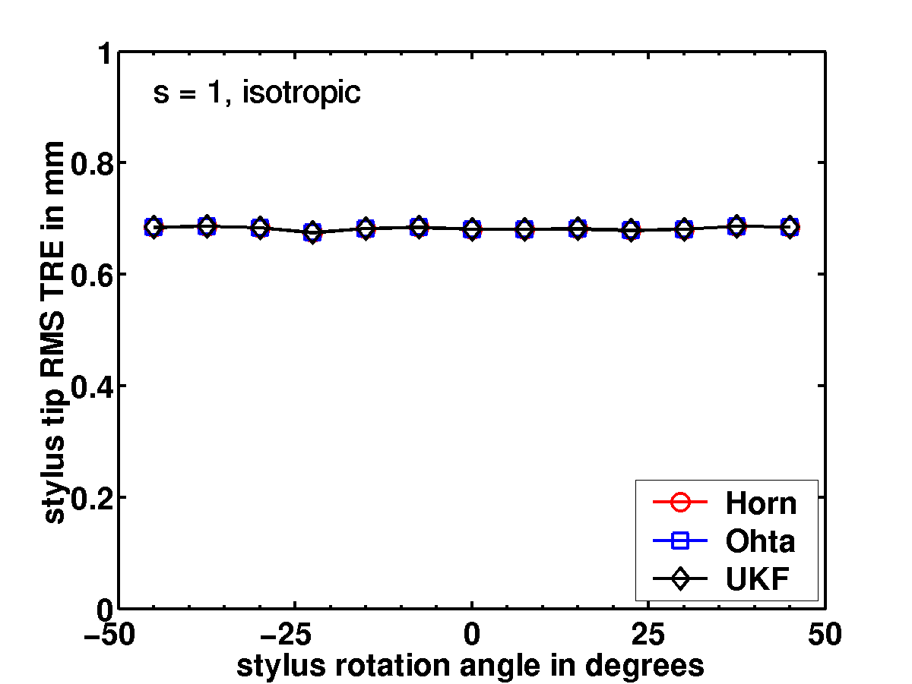
Isotropic FLE
TRE independent of rotation for isotropic noise

Slide 6
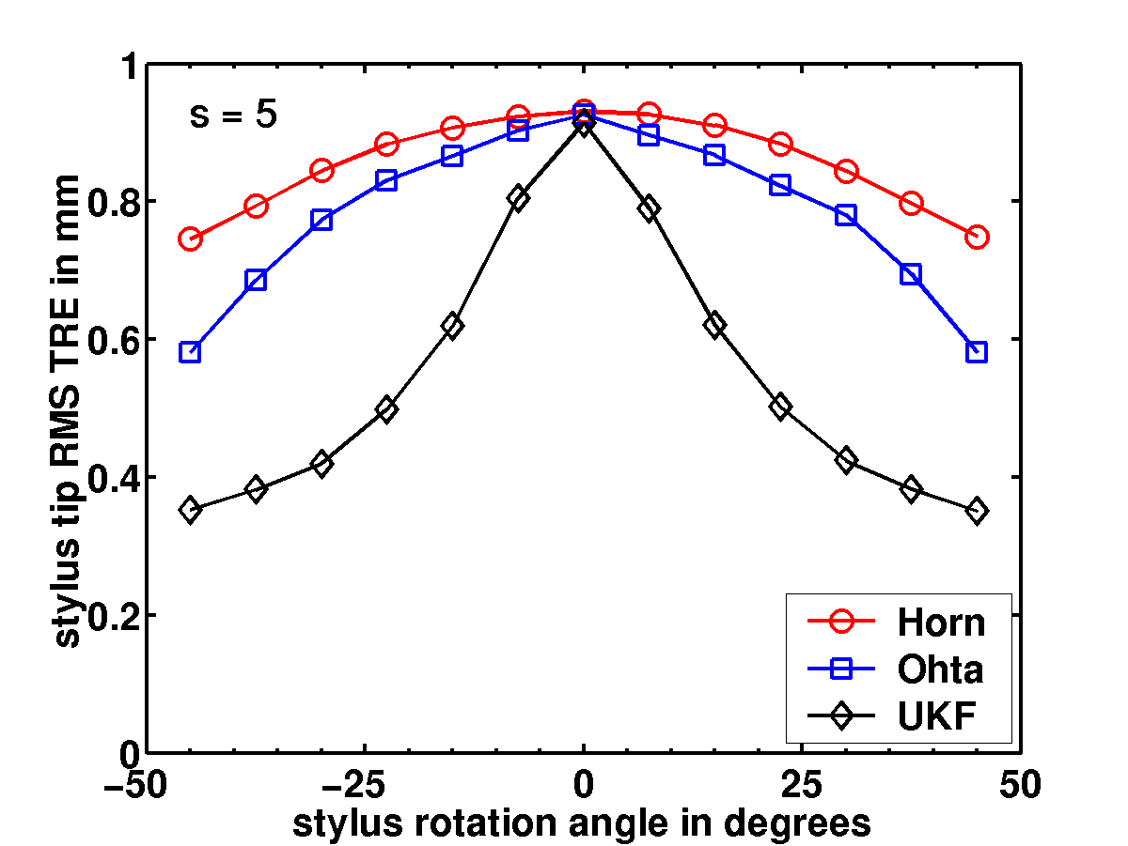
Anisotropic FLE
TRE strongly dependent of rotation for anisotropic noise

Slide 7
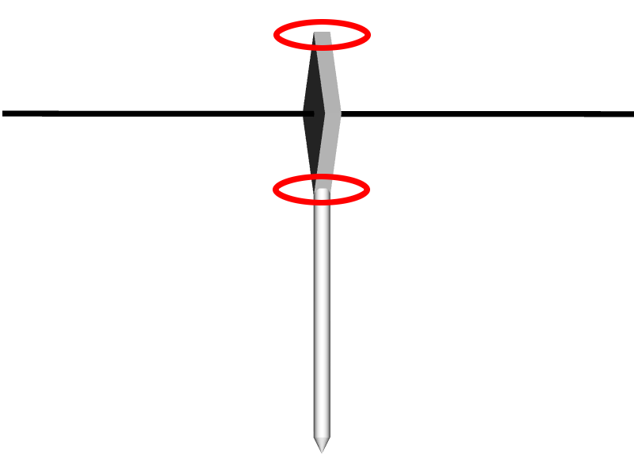
Why the Peak in TRE?
because rotational component of TRE_{RMS} is maximized when DRB faces the tracking camera

Slide 8
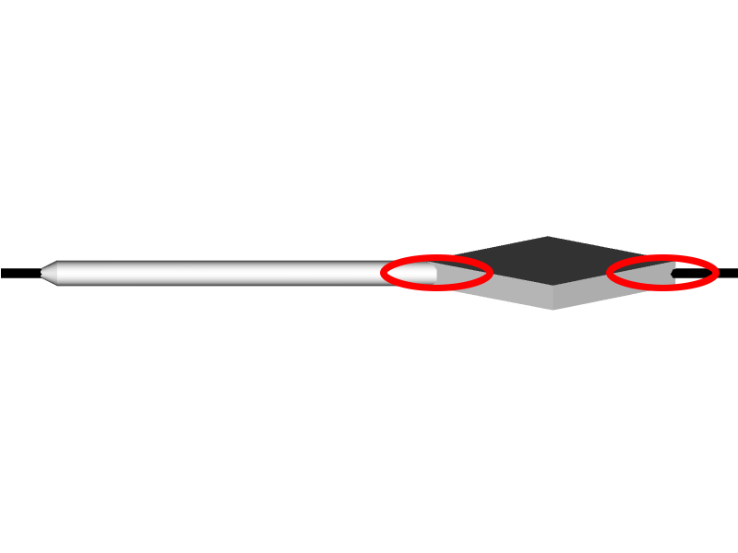
Why the Peak in TRE?
and minimized when the DRB is perpendicular to the tracking camera

Slide 9
Observed TRE
paradoxically, this behavior is exactly the opposite of what is observed in practice
TRE is typically worse when the DRB is rotated away from the camera

Slide 10
Heteroscedastic FLE
in reality, noise in each point almost certainly comes from different distributions
{L}

Slide 11
Heteroscedastic FLE
furthermore, both sets of measured points almost certainly contain noise
{R}

Slide 12
Heteroscedastic FLE
Estimation of nonlinear errors-in-variables models for computer vision applications. IEEE Trans. Pattern Anal. Machine Intell. , 28, 1537-1552, 2006.
arguably better is Matei's PhD dissertation
http://coewww.rutgers.edu/riul/research/theses/abstract/matei_thesis.html
ellipse fitting
fundamental matrix estimation
absolute orientation estimation
camera calibration
trifocal tensor estimation

Slide 13
HEIV Algorithm for Absolute Orientation
Compute the matrices Z_{i} (one for each registration point) from the original noisy measurements
Compute the covariances of the carriers.
Use Horn's method to obtain an estimate of the solution.
Use the HEIV algorithm to obtain an estimate of the quaternion (encodes rotation) and intercept (encodes the translation)
Recover the rotation matrix (from the quaternion) and the translation (from the intercept)

Slide 14
Day 07
Shape-based Registration

Slide 15
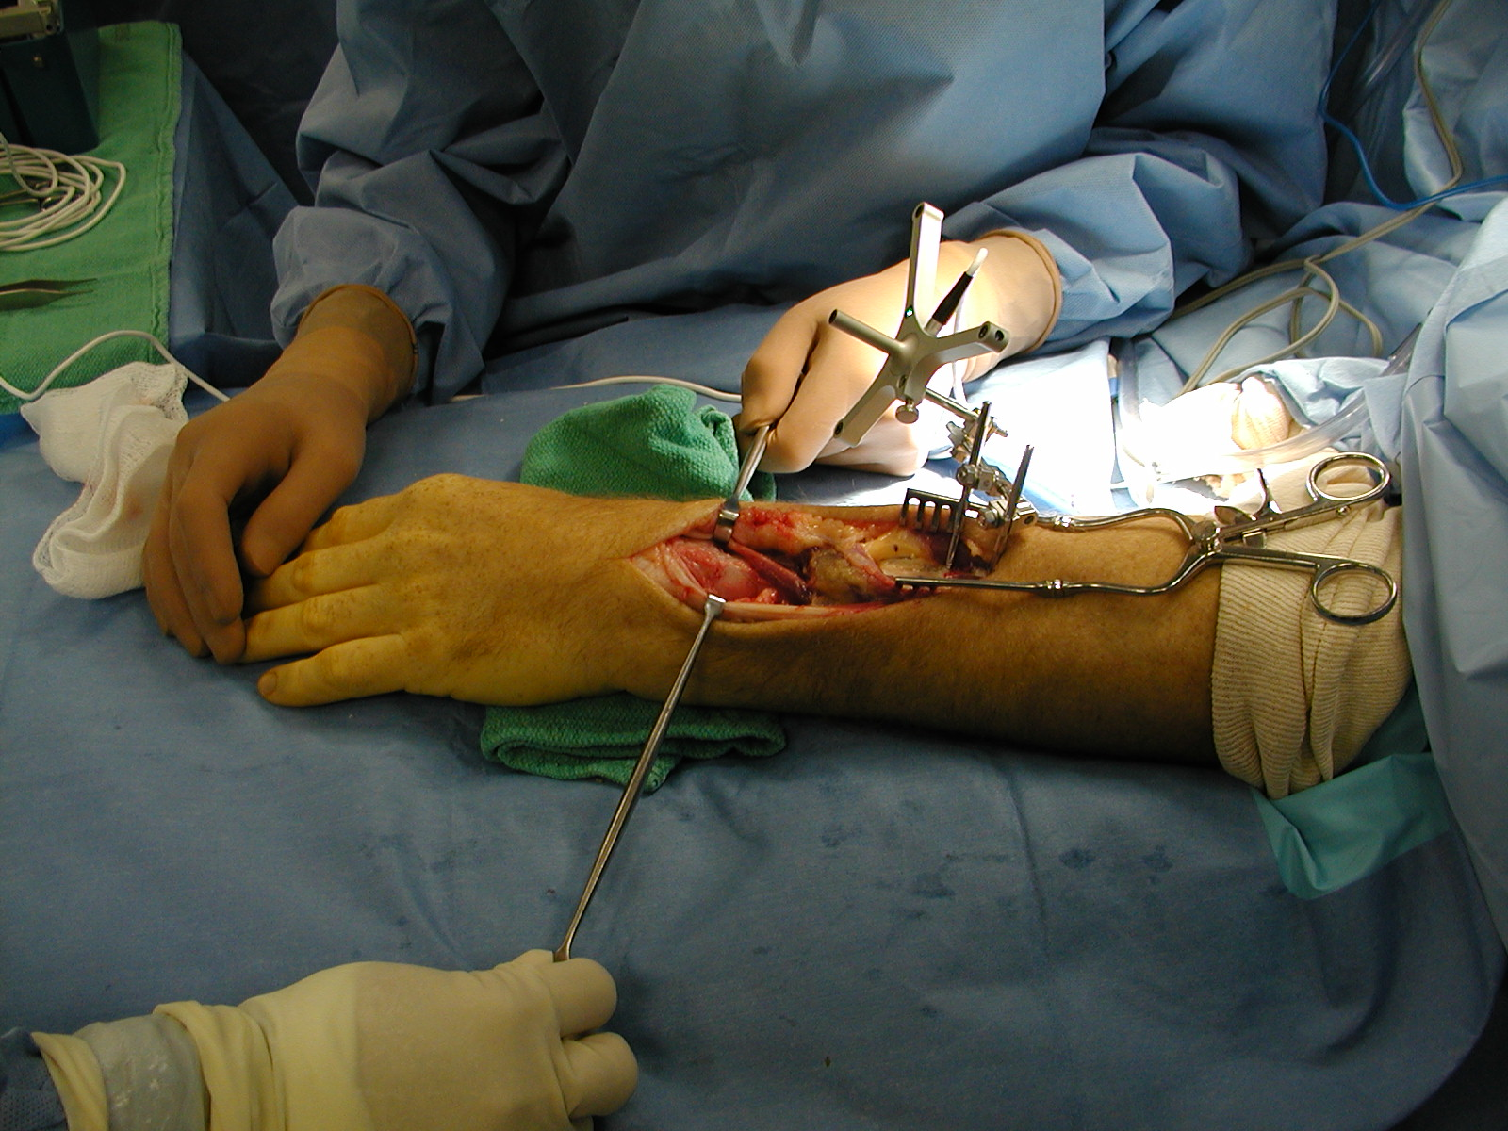

Slide 16
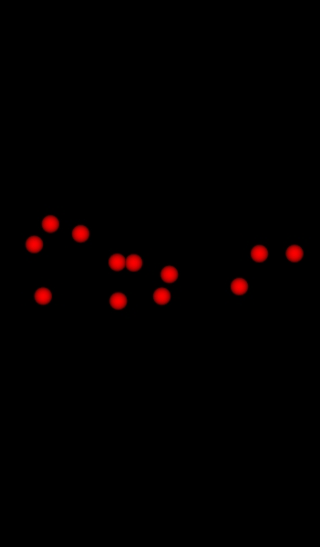
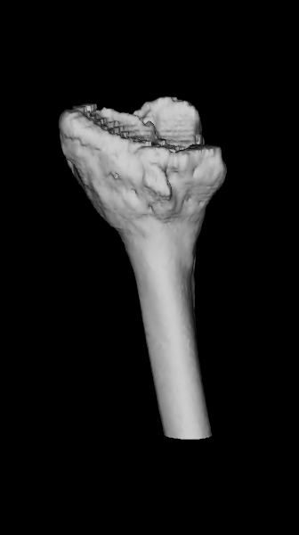
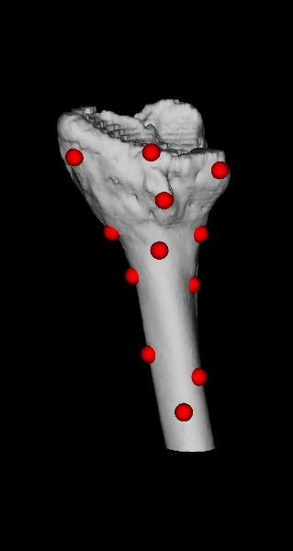
P_{n} = {p_{i=1..n}}
{L}
{R}
patient points
model
find rotation and translation that best matches (registers) the points to the surface
batch process
how many points?
where are the best points?
how do you improve a registration?
how good is the registration?
registered

Slide 17
Relationship to Absolute Orientation
notice that the shape registration problem is similar to the absolute orientation problem
the important difference is that we do not know the point correspondences
i.e., we do not know which surface point x_{i} corresponds to registration point p_{i}
if we did know the correspondences then the problem is solved; just use any solution to the absolute orientation problem

Slide 18
ICP Algorithm
iterated closest point algorithm
Besl and McKay. IEEE Transactions on Pattern Analysis and Machine Intelligence, vol. 14, no. 2, Feb 1992.
solves for the rotation and translation that best aligns a set of points to a surface
surface can have any representation that allows for a point-to-surface distance computation

Slide 19
ICP Algorithm
Find an initial guess for the rotation R and translation d.
Apply R and d to P to obtain Q₀ = {q₁, ..., q_{n}}
For k = 1, 2, ....
Find the points on the surface Y_{k} = {y₁, ..., y_{n}} closest to Q_{k-1}.
Use Horn's method to match P to Y_{k}; this yields the new estimate for R and d.
Apply R and d to P to obtain Q_{k} = {q₁, ..., q_{n}}
Compute the mean squared error
Until for some threshold value

